Slide 1

Computer Systems Security Flash Messenger Project
Baran Azak 10636432
Sumit Gupta 10634262
Ananya Sahu 10627321

Slide 2
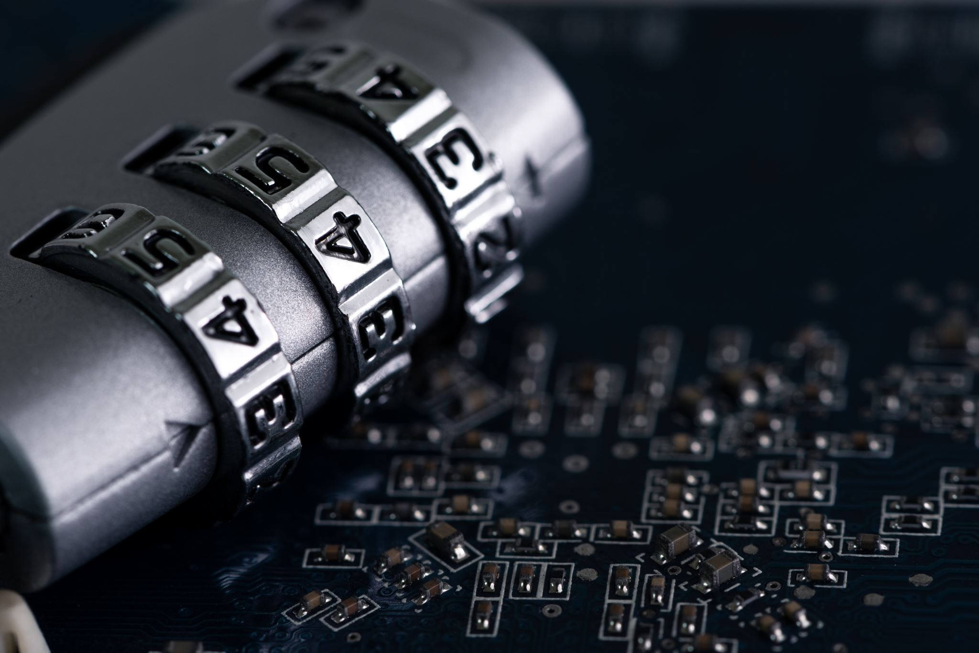
Introducing Flash Messenger
Flash Messenger is a secure messaging solution
Addressing data breaches, unauthorized access, and sensitive data retention
Cutting-edge encryption techniques for ultimate privacy and security

Slide 3
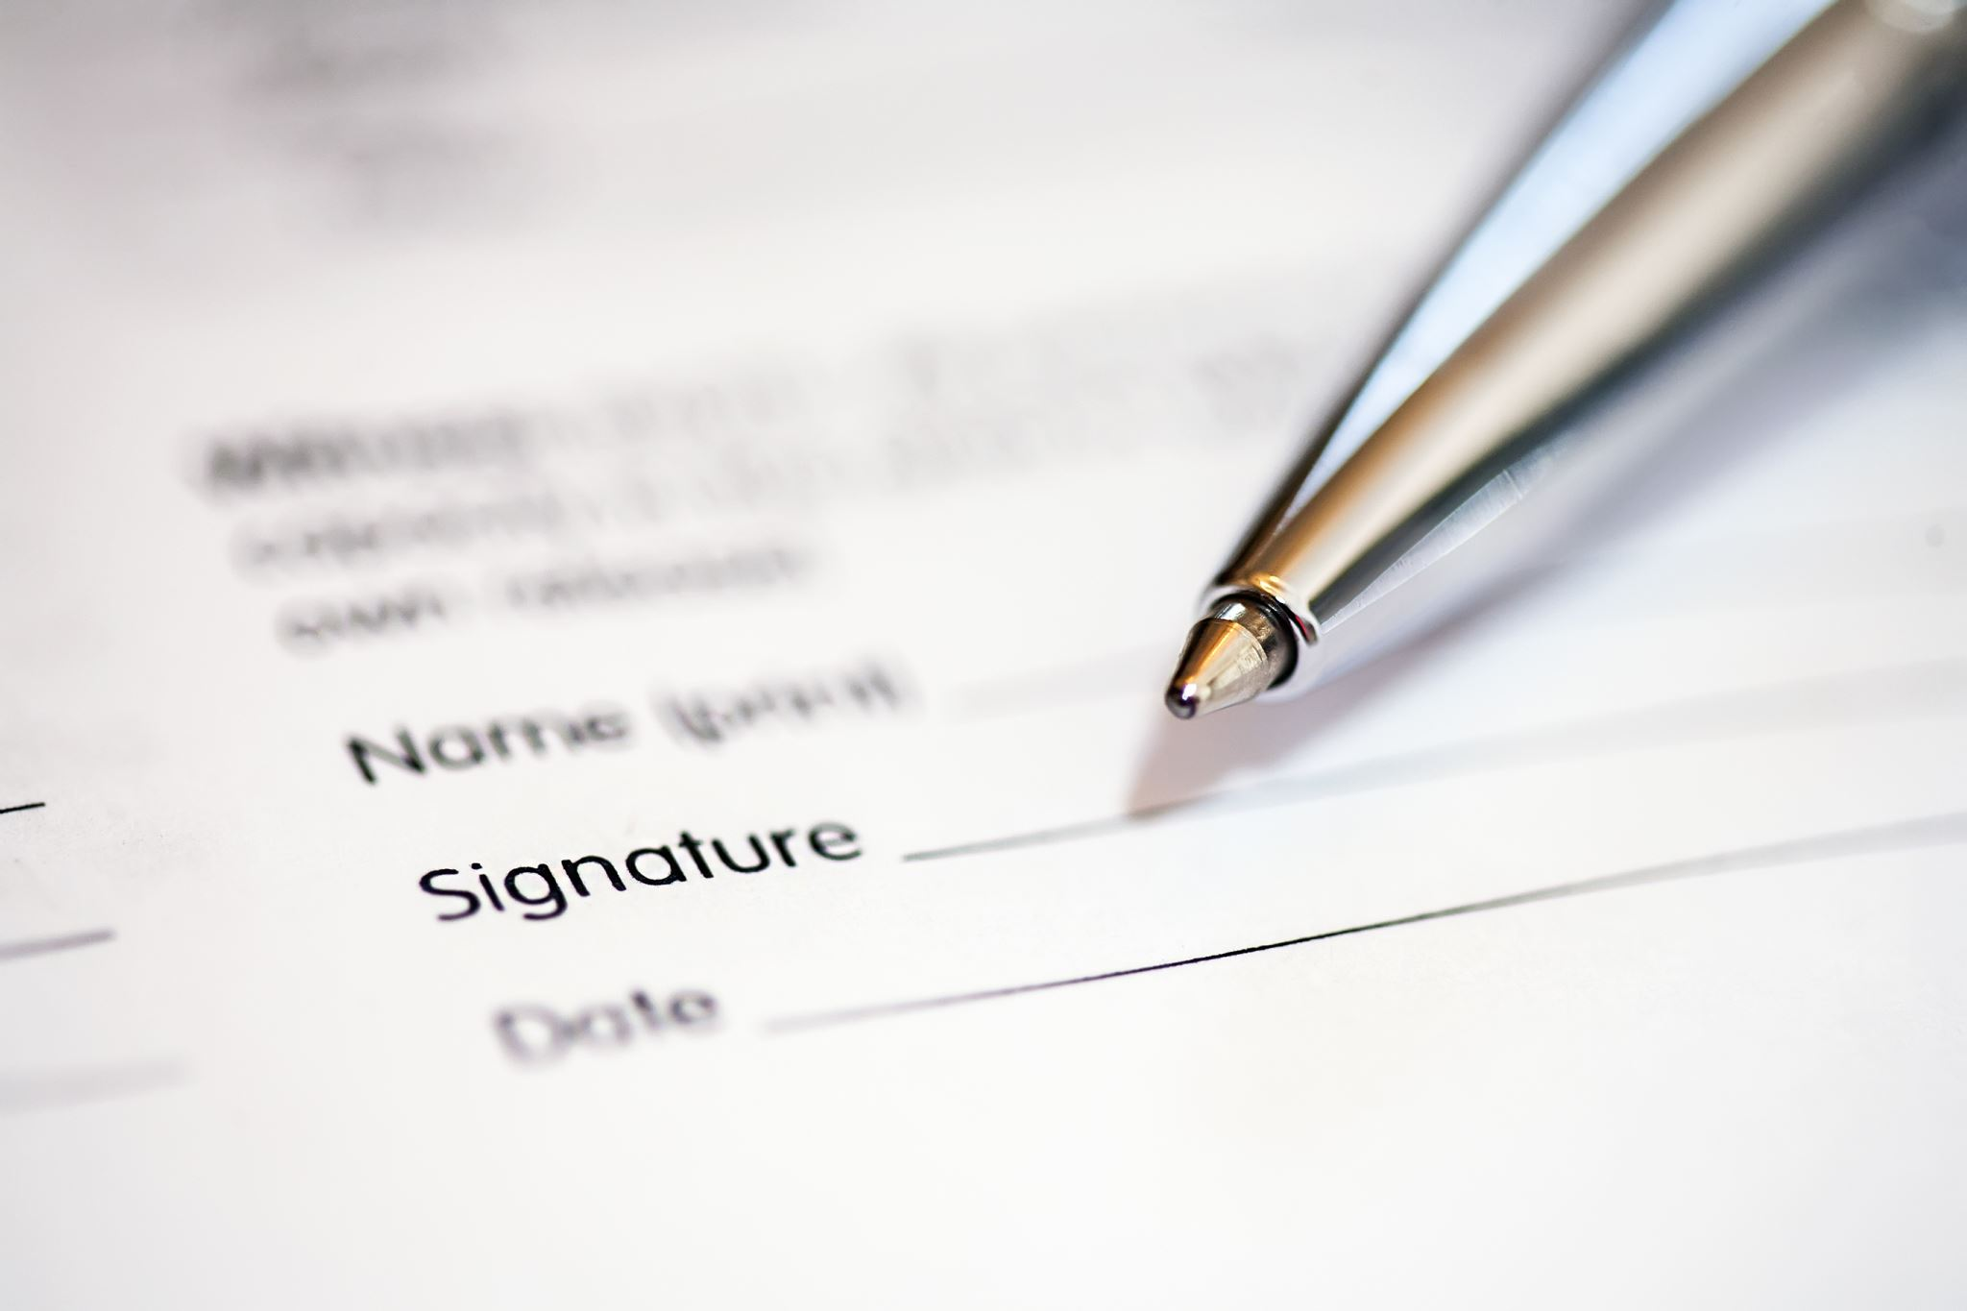
Requirements
Functional requirements
User Authentication via Facebook
Message Composing and Sending
Secure Messaging
View Once Only
Non-functional requirements
Security
Reliability
User-Friendly Interface
Privacy
Compliance

Slide 4
Security Requirements
Data Encryption
Secure Authentication
Secure Data Transmission
Message Expiry and Deletion
Session Management
Secure Third-Party Integrations

Slide 5
Assumptions
Third-party Authentication
Facebook Verification.
Genuine Facebook JavaScript SDK connector.
User Device
user will keep the gadget safe.

Slide 6

Flash Messenger’s Features
Secure and encrypted messaging
Login via Facebook
Ephemeral messages for added privacy
User-friendly interface for easy communication

Slide 7

Features
Sending/Receiving Message
User A composes a message in the Flash Messenger app and selects User B as the recipient.
The message is encrypted using User B's public key, ensuring that only User B can decrypt and read it.

Slide 8
Features
Ephemeral Messaging
Flash Messenger offers an ephemeral messaging feature where messages disappear after being read once.
After User B reads the message, it is automatically deleted from their device, ensuring increased privacy.

Slide 9

Ease of Use and Authentication
Designed for simplicity and user-friendliness
Effortlessly compose and send messages
Smooth authentication through Facebook
Leveraging Facebook’s sophisticated infrastructure for secure login

Slide 10
Flow of the application
Key Generation
When a user creates an account on Flash Messenger, the application generates a pair of cryptographic keys for the user - a public key and a private key.
The public key is used for encrypting messages that are intended for the user.
The private key is securely stored on the user's device and is used to decrypt incoming messages.

Slide 11
Secure Login
When a user creates an account on Flash Messenger, the application generates a pair of cryptographic keys for the user - a public key and a private key.
The public key is used for encrypting messages that are intended for the user.
The private key is securely stored on the user's device and is used to decrypt incoming messages.

Slide 12
Receiving Message
When User B opens the Flash Messenger app and checks their messages, they receive the encrypted message from User A.
User B's private key is used to decrypt the message, making it readable.

Slide 13
Benefits of Flash Messenger:
Total privacy and peace of mind
Protection from prying eyes
Hassle-free and seamless user experience
Trustworthy sign-in procedure with Facebook authentication

Slide 14
Vulnerability Report
Insecure Cryptography
consider raising the modulus length to 3072 bits or higher.
Lack of Rate Limiting
No limit for the number of login attempts.
Lack of Input Validation
Weak Session Management
user session hijacking is possible.
Insufficient Third-Party Security Assessment

Slide 15
Conclusion
Flash Messenger provides a secure and private messaging experience by utilizing cutting-edge encryption techniques, ephemeral messaging, and secure key management to safeguard communications from prying eyes and data breaches.

Slide 16

Thank you! Feedback and Questions

